Slide 1
DevOps ext program Winter 2020-2021
Creating basic DevOps chain connecting local machine, GitHub repository and GCP instance
Andrii Kozak

Slide 2
Task descriptions
Automated and fast deployment site to server after changes.
In project I used:
Google Cloud Platform;
GitHub;
Jenkins;
Terraform;
Bash scripts;
Docker, docker-compose;
Django;
Bonus+: Prometheus, Grafana.

Slide 3
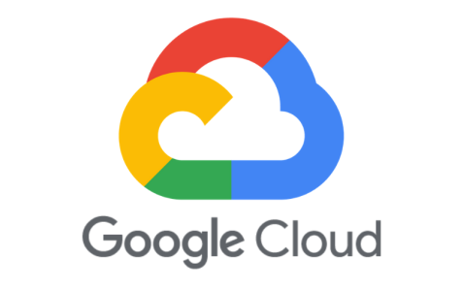
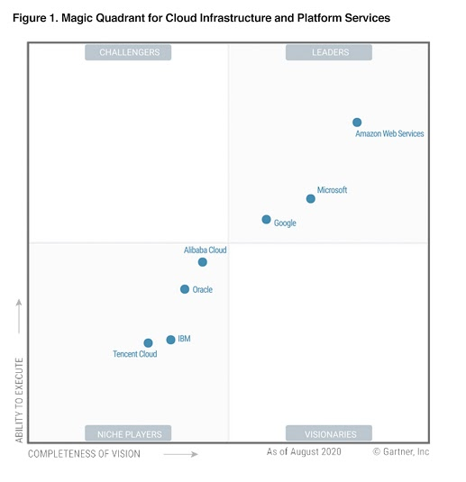
Google Cloud Platform
Google Cloud Platform (GCP), offered by Google (company), is a suite of cloud computing services that runs on the same infrastructure that Google uses internally for its end-user products, such as Google Search, Gmail, file storage, and YouTube. Alongside a set of management tools, it provides a series of modular cloud services including computing, data storage, data analytics and machine learning.

